Slide 1
Random Forest for Fraud Detection
Martin

Slide 2
Introduction
Fraud detection is becoming an increasingly important endeavor for credit card companies as payments are quickly becoming cashless around the world.
The dataset we will be learning from was created by using credit card transactions in September 2013 by European credit card holders.
We will be using these transactions to attempt to build and teach a Random Forest model that will be able to detect fraudulent credit card transactions.

Slide 3
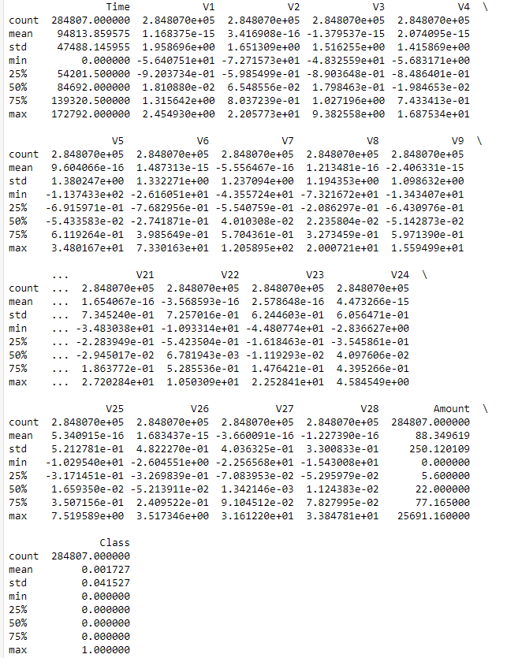
Checking the Data
We know that starting off, we have almost 285,000 records.
These have 28 post-PCA features as well as:
Time between transactions
Amount
Class (1 for fraud, 0 for not)
Initial checks showed that none of the fields had missing values

Slide 4
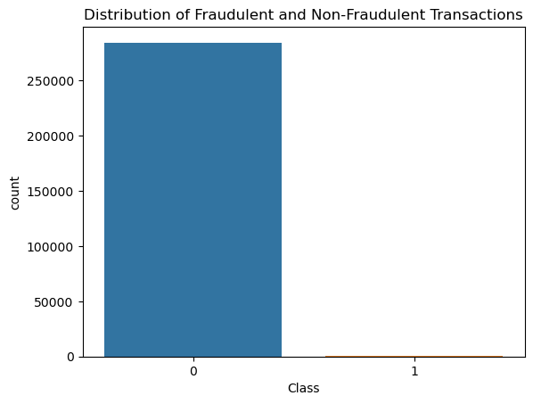
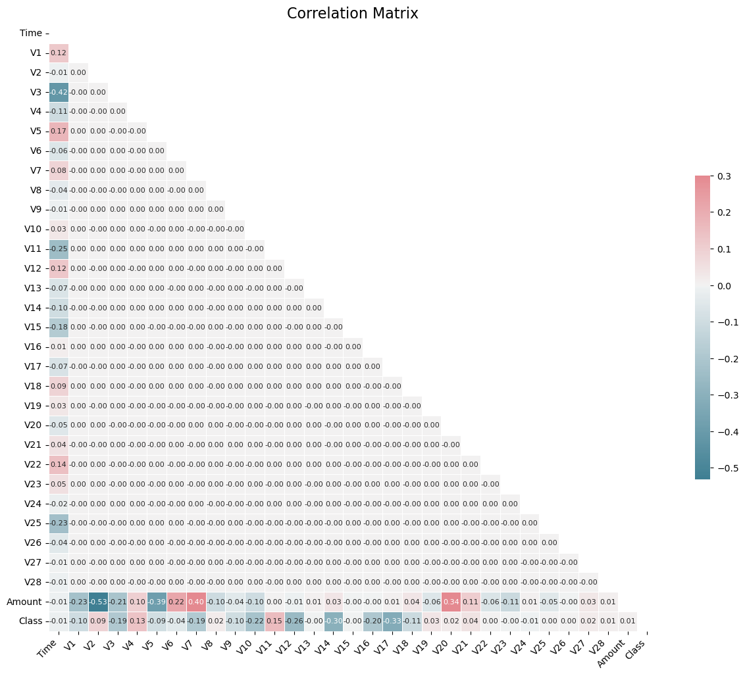
Visualization of Data Distribution
Notes:
Here we can see that the amount of transactions that fit between the two classes are incredibly imbalanced. Part of the reasoning behind using the Random Forest was because it excels at datasets with imbalance classes.
After we adjusted the standard correlation matrix to make it more legible, we can see that the time between transactions and amount of many spent seem to have the strongest relation to each other and the various post PCA features.
We also detected 138,488 outliers when we used IQR to find them. With such a large number, we decided to keep the outliers in as it would challenge the model if there was a large number of outliers in non-fraudulent cases and it more accurately reflects the nature of purchases.

Slide 5
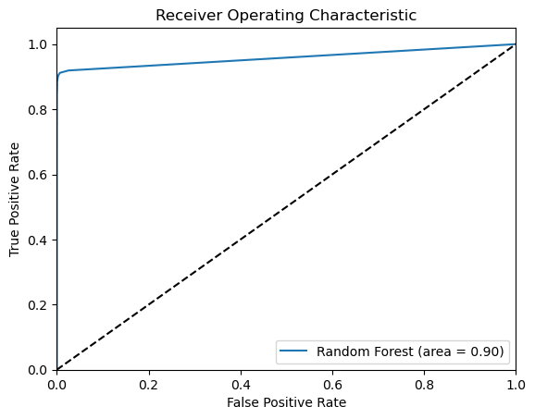
Graphing the Results
Notes:
This graphic shows the performance of the model at a quick glance using the Receiver Operating Characteristic Curve. It shows our general trend toward a high true positive rate, though false positives did remain fairly high. We can then move on to the comparisons against the tuned version and other models.

Slide 6
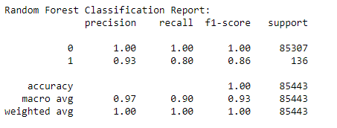
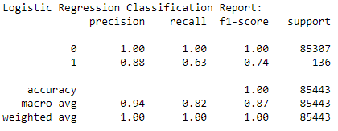
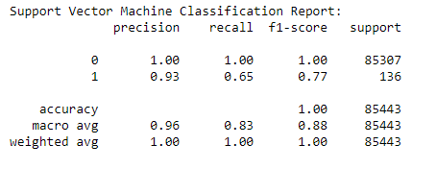
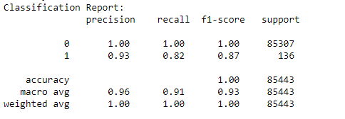
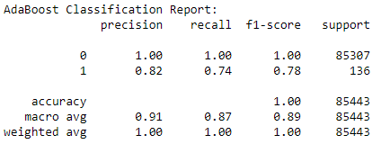
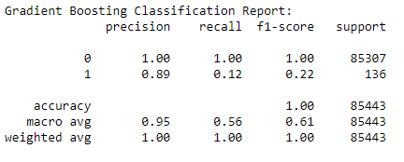
Comparisons
Notes:
On the top left, we have the baseline parameters and, on the bottom, left we have the results after tuning. As you can see, these aren’t all that different with only a marginal gain in prediction.
Overall, you can see that the random Forest performed the best out of all of the models. I do thing this came down to the fact that the model is so robust against the large imbalance between our two classes.
Subjectively, I do feel that some of the models completed faster than our baseline but that isn’t something that was backed up by data that our tests measured.

Slide 7
Conclusion
Our baseline Random Forest model performed spectacularly having an accuracy for predicting credit card fraud at above a 90% rate.
The model likely outperformed similar models due to its robust nature against things like class imbalance
In future comparing the execution times of the models may be an interesting test as you can compare efficiency against accuracy.
This may be helpful for fraudulent transactions, as the quicker they are found, the easier it is to stop and the less money the company loses to this fraud.

